Slide 1
N.E.A.T - FLAPPY BIRDs
Aman Sharma - B2021005
Davis John - B2021016
Luv Saxena - B2021023
Manali Hedaoo - B2021025
Sumit Grover- B2021048

Slide 2
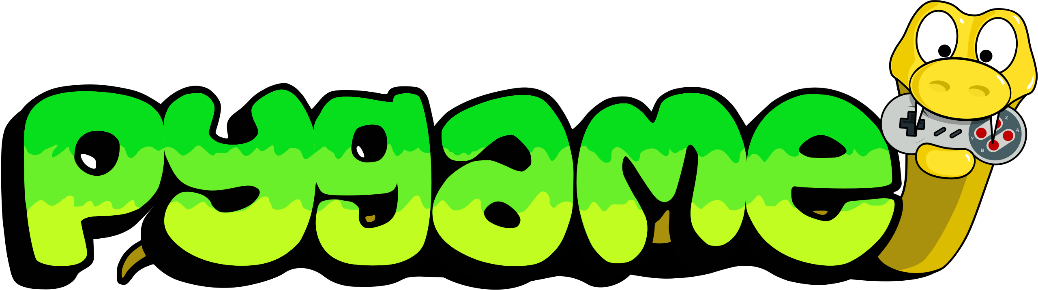
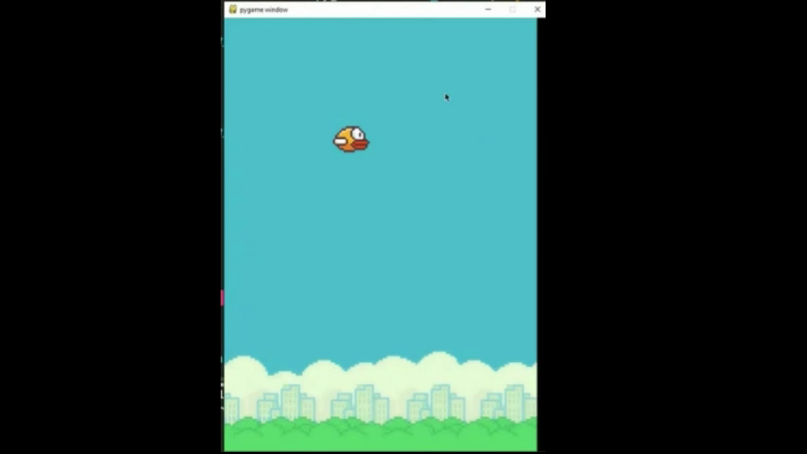
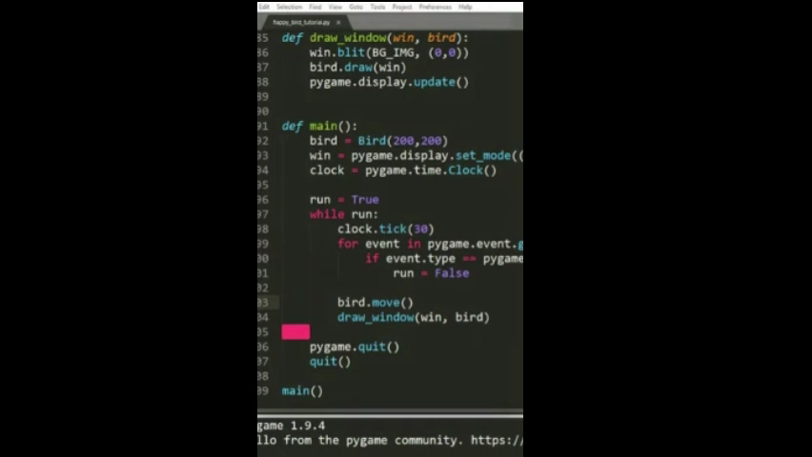
Initial Game Setup
Introducing the clouds, floor and the bird
Animating the bird to move its wings
Adding the falling & the jumping functionality
Looping over & maintaining the environment state

Slide 3
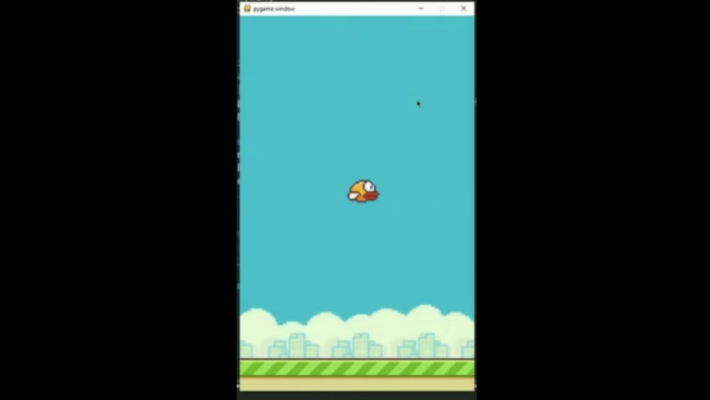
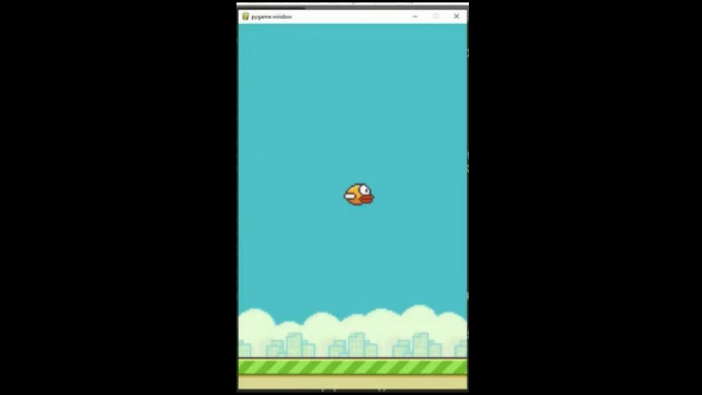
Environment Setup
Animating bird & floor to resemble gameplay
Generating pipes, while calculating random heights with enough space for jump
Looping over & maintaining the environment state

Slide 4
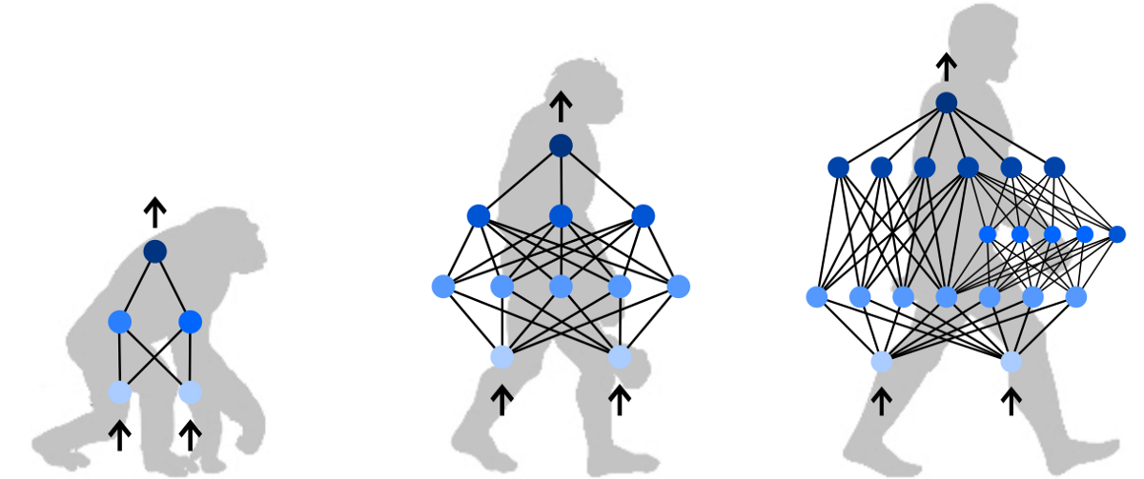
N.E.A.T
NeuroEvolution of augmenting topologies

Slide 5
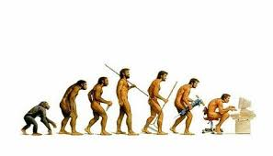
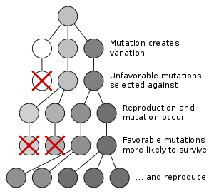
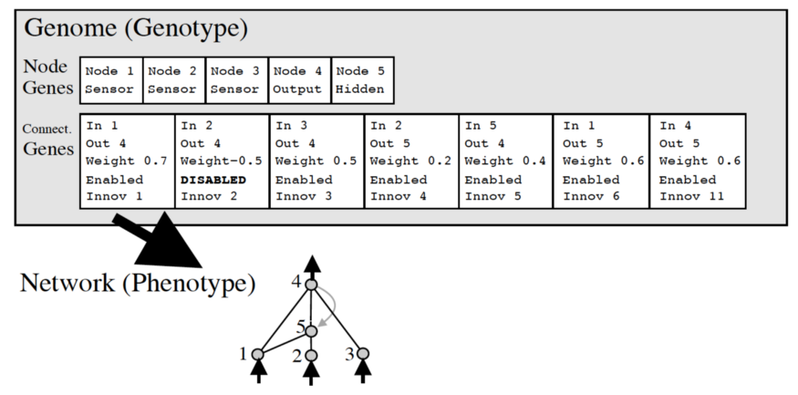
“Survival of the FITTEST”
N.E.A.T
N.E.A.T
“Neural Networks through Augmented Topologies” - describes algorithmic concepts of self-learning machines that are inspired by genetic modification in the process of evolution.

Slide 6
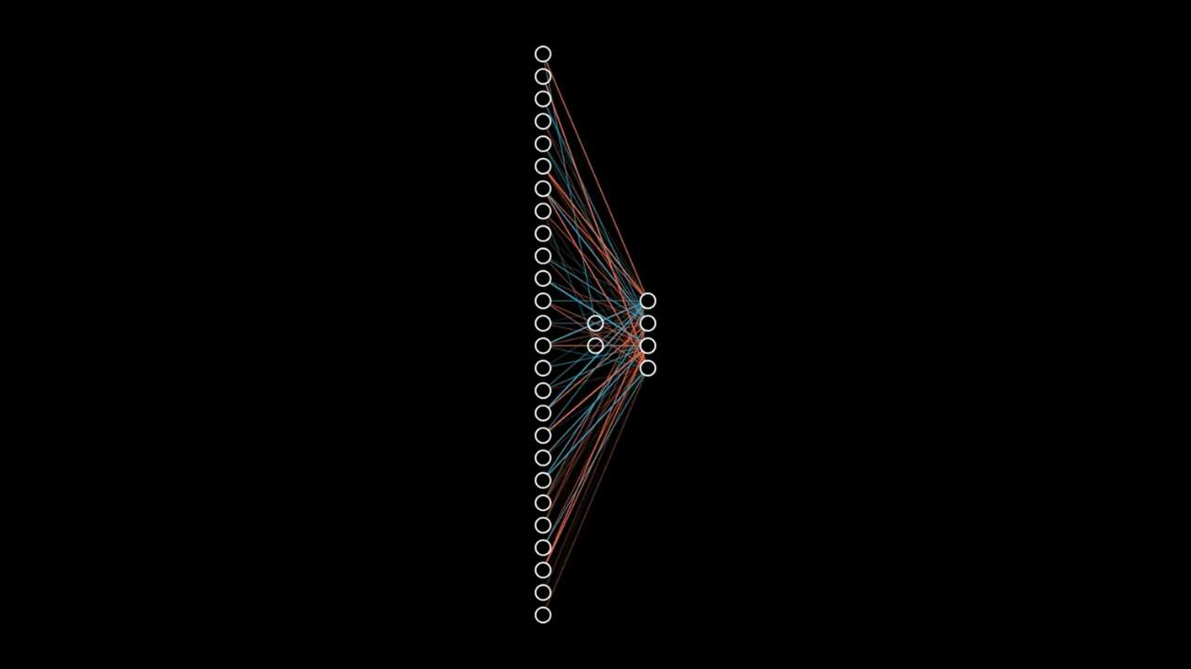
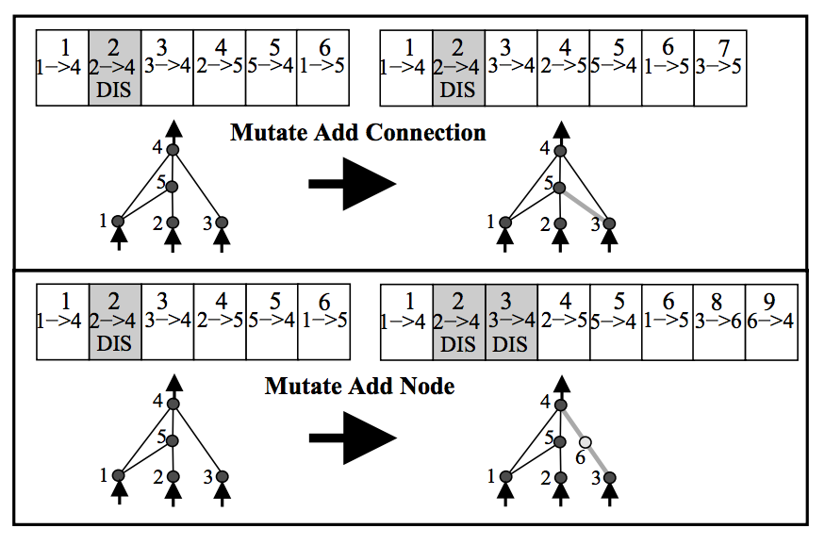
N.E.A.T – Mutation Explained

Slide 7
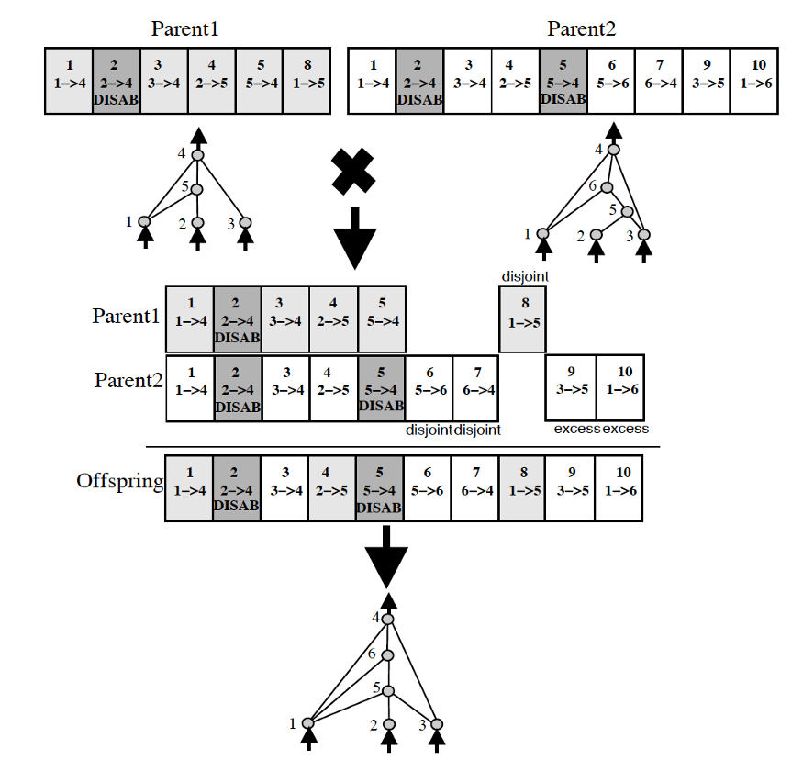
Competing Conventions & Speciation
“Blindly crossing over the genomes of two neural networks could result in networks that are horribly mutated and non-functional. If two networks are dependent on central nodes that both get recombined out of the network”
“Adding new connection or node before any optimization of weights have occurred often leads to a lower performing individual.”
Explicit fitness sharing

Slide 8
AI LEARNS
Bird
Top Pipe
Bottom Pipe
Inputs
Outputs
Activation Function
Population Size
Fitness Function
Maximum Generations
Jump?

Slide 9
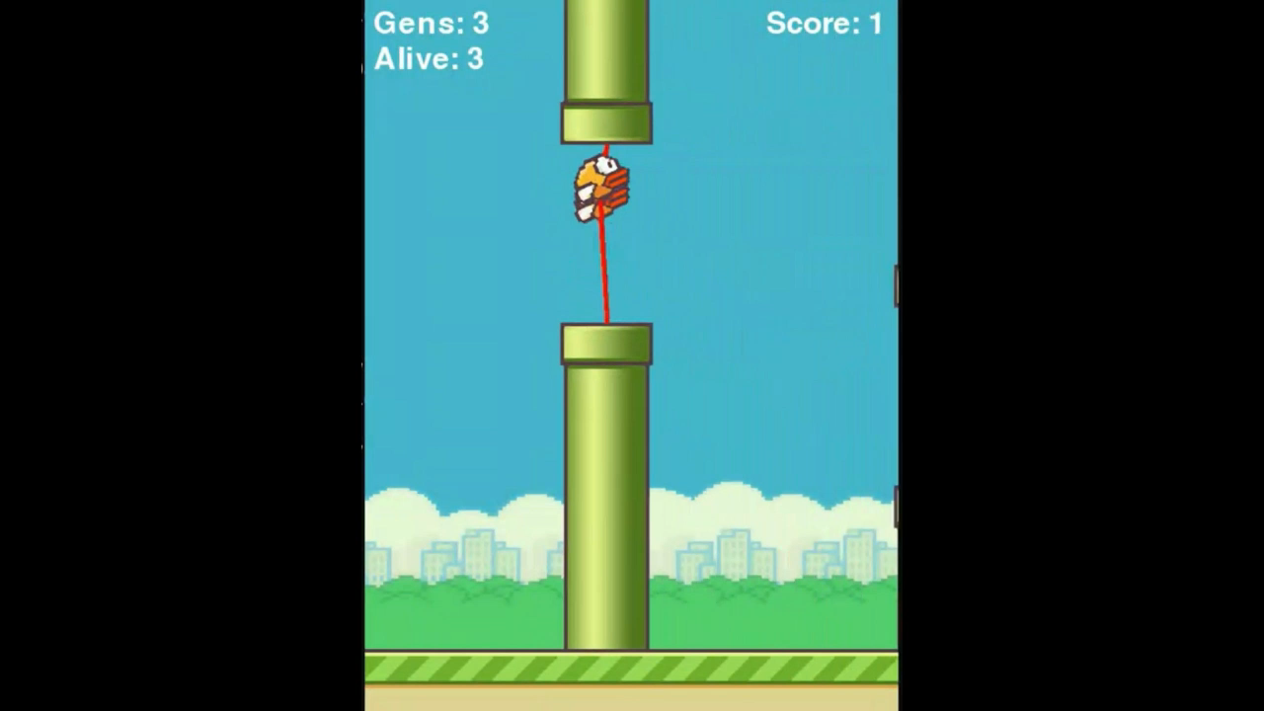
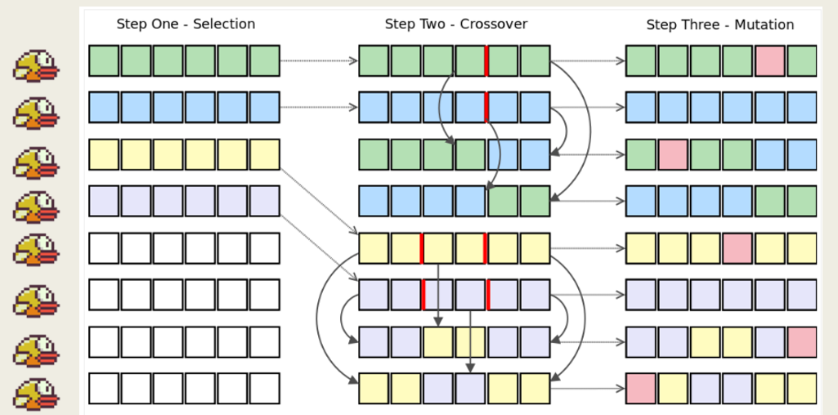
FLAPPY BIRD

Slide 10
Thank you !!

